Slide 1

SIX1015 Science, Technology and Society Semester 2 2025/2026
Sociology of Science and Technology- part 1

Slide 2
About the study- Week 4 and 5

Slide 3
Focus: how students learn to analyse issues related to science, technology, and sustainability
Participation is voluntary
It will not affect your grades
No personal or sensitive information is collected
Details are available in the Participation Information Sheet (PIS) in Spectrum

Slide 4
You are invited to complete:
a pre-survey (today)
a post-survey (Wednesday next week- 8 April)
Class activities and assignments may be analysed in an anonymised way.
By completing the survey, you indicate your consent.

Slide 5
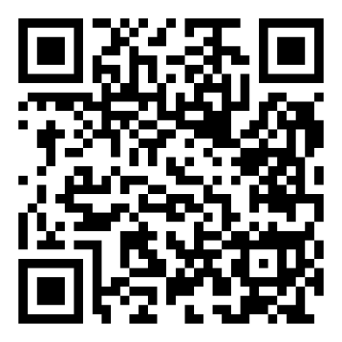
Pre-Survey
Click link in Spectrum/ Scan the QR code below:

Slide 6
Sociology of Science and Technology

Slide 7
Definition and scope
Study on social aspect of science-Science as a social institution
The sociology of science examines a variety of connected matters:
its social structure
the processes involved in the production of scientific knowledge.
the effects of science on society; in turn.
the ways in which it is conditioned by its social and cultural contexts

Slide 8
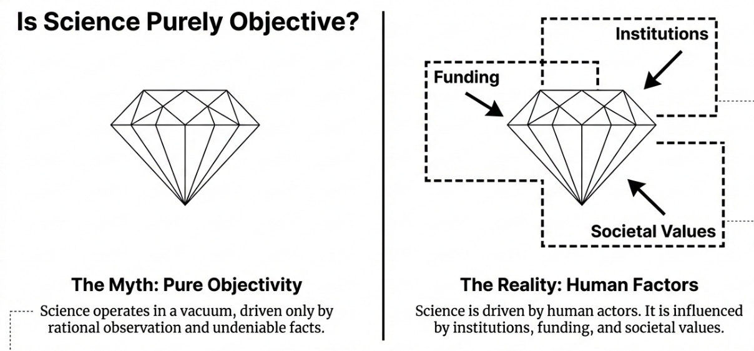

Slide 9
Science is a social institution
Has rules, norms, and values (e.g. objectivity, peer review)
Operates through structures and systems (e.g. universities, labs, funding bodies)
Involves roles and authority (e.g. scientists, experts, journals)
Is embedded in society and interacts with politics, economy, and culture
Society
Science

Slide 10
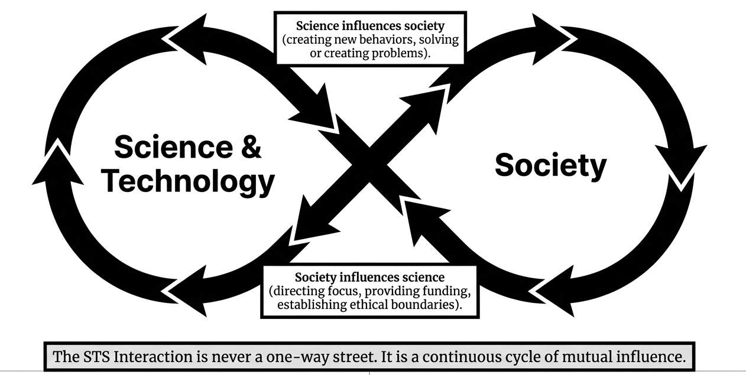

Slide 11
Why Sociology of Science and Technology Matters?
Understanding the system
Understanding the human side
Think more critically about science
Being a more responsible scientist

Slide 12
Internal Sociology of Science

Slide 13
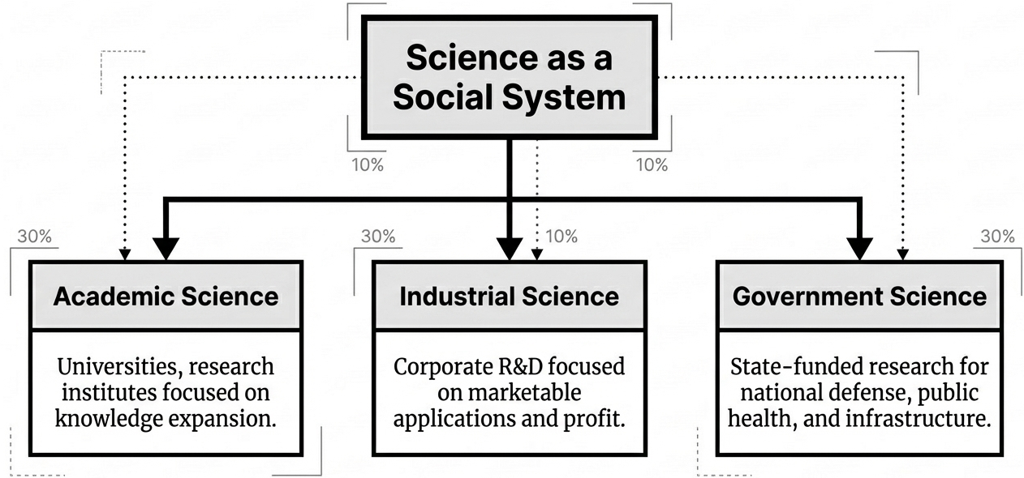

Slide 14
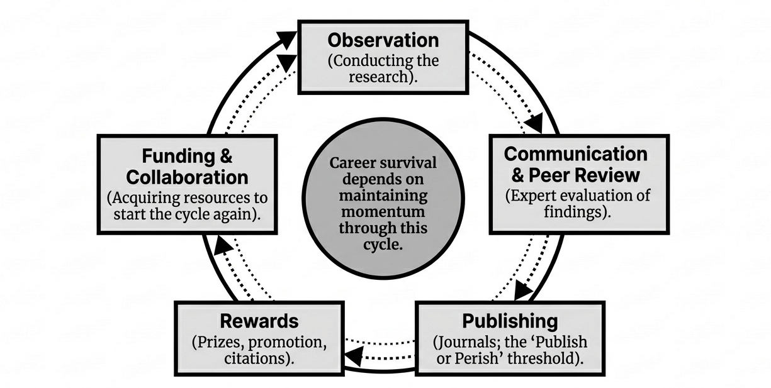
The Academic Flywheel

Slide 15
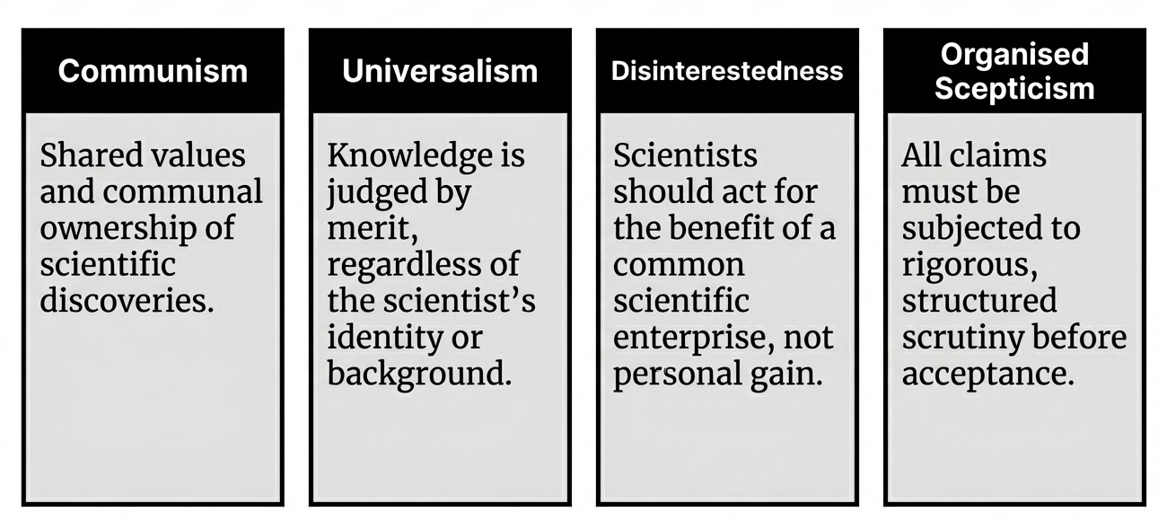
The Mertonian Norms

Slide 16
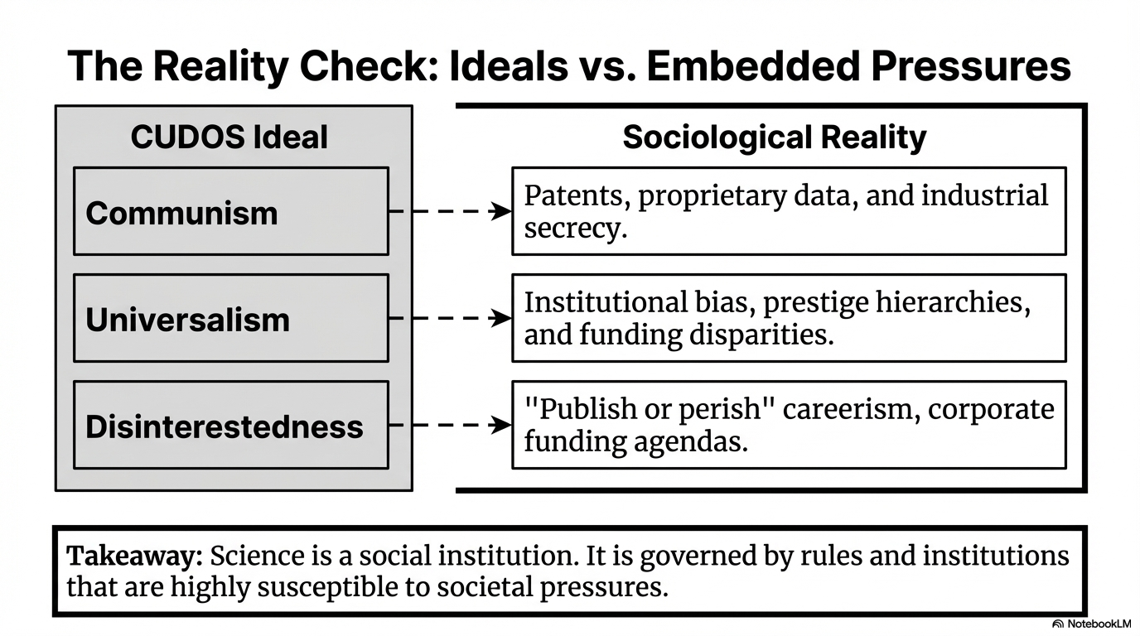

Slide 17
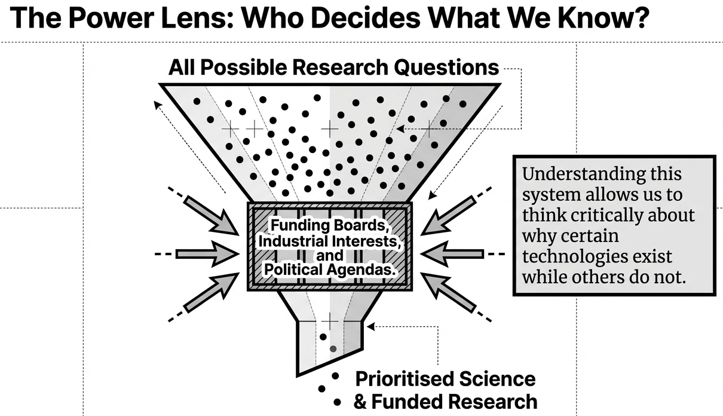

Slide 18
Quick activity
Consider the development of Artificial Intelligence (AI) in your country
What is ONE factor that can influence AI research?
Type your answer in the chat — one word or short phrase is enough

